Slide 1
Introduction to Quantum Hardware
A QHardware Tutorial Series
Part-2

Slide 2
Quantum Hardware Technologies
The most essential part of a quantum computer is a quantum processor.
At present, there are numerous quantum processor technologies exist to build a quantum computer
Trapped-ion quantum computer
Superconducting qubit quantum computer
Photonic quantum processor
Semiconducting qubit quantum processor
Quantum dot
Nuclear magnetic resonance quantum computing (NMRQC)

Slide 3
How a Classical Computer Works
Classical computing is another name for binary computing.
In this traditional approach to computing, information is stored in bits that are represented logically by either a 0 (off) or a 1 (on).
A classical bit is either on or off, but a qubit can be on and off at the same time, a condition known as superposition.
One of the key differences of quantum computing with respect to classical computing is computation-in-place.
The basic classical computer with a CPU has an input register, output register, and memory unit in addition to the CPU. The CPU, on the other hand, is composed of processor and control unit, while the processor contains combinational logic and registers.
The input data are stored in the corresponding register, and the control unit indicates when the data can be processed by the combinational logic, based on instructions written in the memory. Once the computation is done, the result is stored in the output register.

Slide 4
How a Quantum Computer Works
In most quantum gates-based quantum computing, the information is encoded into the quantum states of qubits and these states evolve based on the action of unitary operators.
Once the measurements are done, their results are classical and can be further processed by a classical computer.

Slide 5
Hardware Structure of a Quantum Computer
To assist in conceptualizing the necessary hardware components for an analog or gate-based quantum computer, the hardware can be modeled in four abstract layers:
the “quantum data plane,” where the qubits reside;
the “control and measurement plane,” responsible for carrying out operations and measurements on the qubits as required;
the “control processor plane,” which determines the sequence of operations and measurements that the algorithm requires, potentially using measurement outcomes to inform subsequent quantum operations;
and the “host processor,” a classical computer that handles access to networks, large storage arrays, and user interfaces. This host processor runs a conventional operating system/user interface, which facilitates user interactions, and has a high bandwidth connection to the control processor.

Slide 6
Quantum Data Plane
The quantum data plane is the “heart” of a QC.
It includes the physical qubits and the structures needed to hold them in place.
It also must contain any support circuitry needed to measure the qubits’ state and perform gate operations on the physical qubits for a gate-based system or control the Hamiltonian for an analog computer.
Control signals routed to the selected qubit(s) set the Hamiltonian it sees, which control the gate operation for a digital quantum computer.
For gate-based systems, since some qubit operations require two qubits, the quantum data plane must provide a programmable “wiring” network that enables two or more qubits to interact.
Unlike a classical computer, where both the control plane and the data plane components use the same silicon technology and are integrated on the same device, control of the quantum data plane requires technology different from that of the qubits, and is done externally by a separate control and measurement layer

Slide 7
Control and Measurement Plane
The control and measurement plane converts the control processor’s digital signals, which indicates what quantum operations are to be performed, to the analog control signals needed to perform the operations on the qubits in the quantum data plane.
It also converts the analog output of measurements of qubits in the data plane to classical binary data that the control processor can handle.
The generation and transmission of control signals is challenging because of the analog nature of quantum gates; small errors in control signals, or irregularities in the physical design of the qubit, will affect the results of operations.
The errors associated with each gate operation accumulate as the machine runs.
Any imperfection in the isolation of these signals will cause small control signals to appear for qubits that should not otherwise be addressed during an operation, leading to small errors in their qubit state

Slide 8
Control Processor Plane
The control processor plane identifies and triggers the proper Hamiltonian or sequence of quantum gate operations and measurements (which are subsequently carried out by the control and measurement plane on the quantum data plane).
These sequences execute the program, provided by the host processor, for implementing a quantum algorithm.
One of the most important and challenging tasks of the control processor plane will be to run the quantum error correction algorithm.
Significant classical information processing is required to compute the quantum operations needed to correct errors based upon the measured syndrome results, and the time required for this processing may slow the operation of the quantum computer.

Slide 9
Qubit Technologies
Several technologies are used to make hardware qubits for quantum computer.
Numerous types of qubit technologies exist nowadays such as superconducting qubits, trapped ion qubits, photonic qubits, topological qubits, quantum dot qubits, nuclear magnetic resonance (NMR) qubits etc.
Among these technologies, superconducting qubits are used mostly where IBM uses transmon qubit and Google has implemented sycamore superconducting qubit processor.
Superconducting qubits are currently the most advanced qubit technology..

Slide 10
Qubit Technologies
Most existing quantum computers use superconducting qubits. They use metal-insulator-metal sandwiches called Josephson junctions.
To turn these materials into superconductors – materials that electricity can run through with no loss – scientists lower them to extremely cold temperatures.
The quantum computers you interact with in IBM Quantum use a physical type of qubit called a superconducting transmon qubit, which is made from superconducting materials such as niobium and aluminum, patterned on a silicon substrate.
Besides, trapped ion quantum computer are also popular where ion trap is used to build quantum register

Slide 11
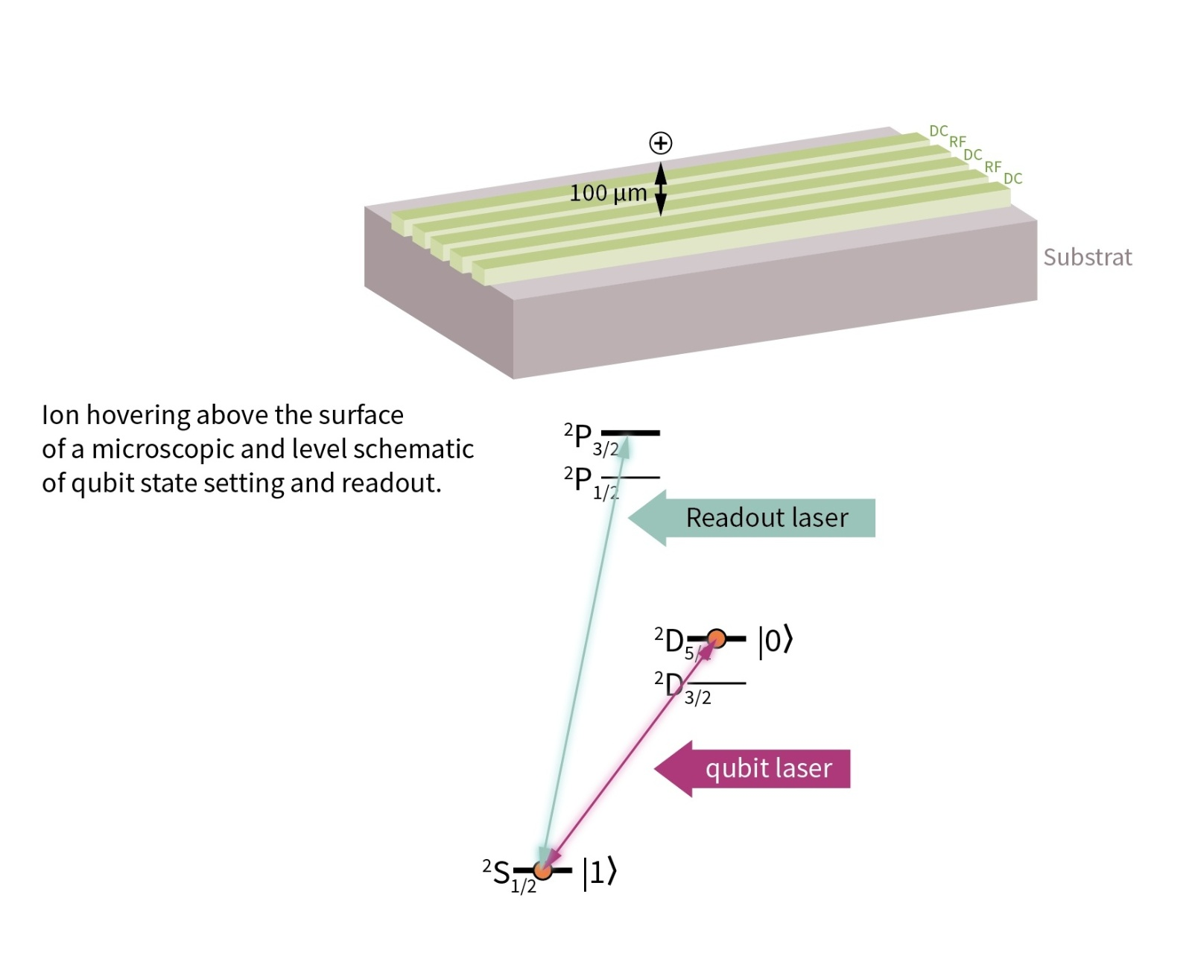
Trapped-ion Quantum Computer
In a trapped ion quantum computer, the qubits are implemented using charged atoms in a cryogenic vacuum.
The ion, for example Ca⁺, Ba⁺ or Be⁺, is captured with DC and RF fields and manipulated with lasers or microwaves.
The qubit is defined by the electron‘s quantum-mechanical state: the ground state is defined as a logical 1, the qubit laser or a microwave pulse elevates the electron into an excited state to implement a logical 0.
Then after the calculations or gate operations have been performed, the resulting state of the qubit has to be read.
That is done by employing the readout laser to elevate the electron to a higher electron orbit from which it will immediately decay and emit one photon that can be detected.
Since the readout laser is tuned to excite the ground state, detected photons indicate that the qubit was a logical 1 before the readout.

Slide 12
Superconducting Qubit QC
In a superconducting circuit computer, the quantum processor is the soul of the computer. This processor is host at the bottom of a cylinder.
Superconducting qubits are among the most promising approaches to building quantum computers.
It is no surprise that this technology is being used by well-known tech companies in their quest to pioneer the quantum era. Google’s Sycamore claimed quantum advantage back in 2019 and, in 2021, IBM built its Eagle quantum computer with 127 qubits.
The central insight that allows for these quantum computers is that superconductivity is a quantum phenomenon, so we can use superconducting circuits as quantum systems that we can control at will.
We can actually bring the quantum world to a larger scale and manipulate it more freely.

Slide 13
Photonic quantum computing
A programmable photonic circuit has been developed that can execute various quantum algorithms and is potentially highly scalable.
This device could pave the way for large-scale quantum computers based on photonic hardware

Slide 14
References
1. National Academies of Sciences, Engineering, and Medicine. 2019. Quantum Computing: Progress and Prospects. Washington, DC: The National Academies Press. https://doi.org/10.17226/25196.
2. Qiskit Metal Documentation- https://qiskit.org/documentation/metal/
3. Qiskit Textbook- https://qiskit.org/learn/
4. A Quantum Engineer's Guide to Superconducting Qubits (https://arxiv.org/abs/1904.06560)
5. Quantum Computation and Quantum Information by Michael A. Nielsen and Isaac Chuang
6. Principles of Superconducting Quantum Computers by Daniel D. Stancil and Gregory T. Byrd

